Slide 1
COVID-19 news app

Slide 2
Summary of the App
International news dashboard application for COVID-19 relevant news (filter to your country of interest)
Integration of Streamlit and data retrieved from NewsApi and European CDC.
News API: free access to reputable news sources from various countries with the provided API token.
European CDC: daily updates on COVID-19 numbers
Objectives:
Provide a snapshot of important daily COVID-19 statistics: death rates, total cases, and top 10 countries with highest fatality rates
Retrieve top news headlines on COVID-19 filtered by country of interest

Slide 3
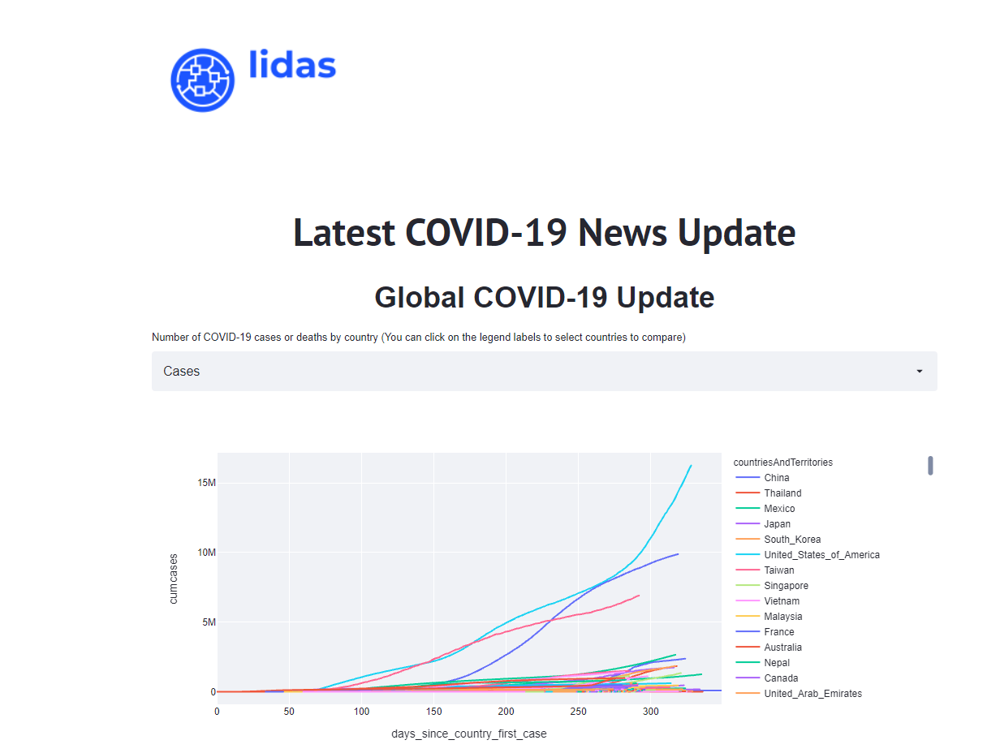
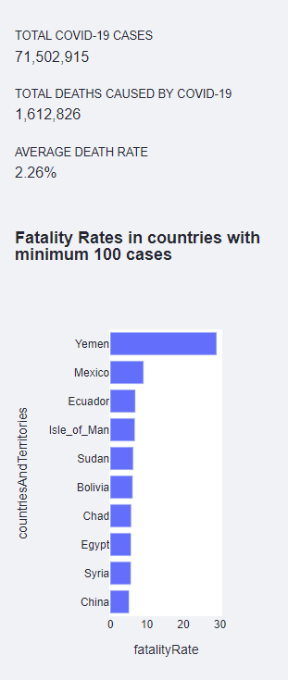
Global COVID-19 Statistics

Slide 4
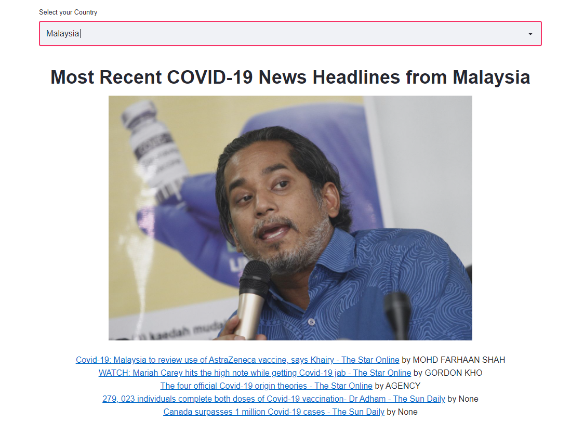
Retrieval of top 5 news headlines on COVID-19 from various Malaysian news sources

Slide 5
AZURE COVID-19 forecast app

Slide 6
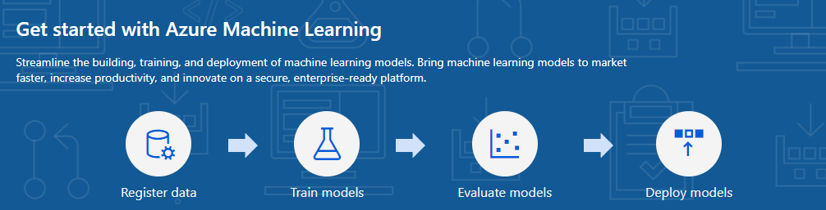

Slide 7
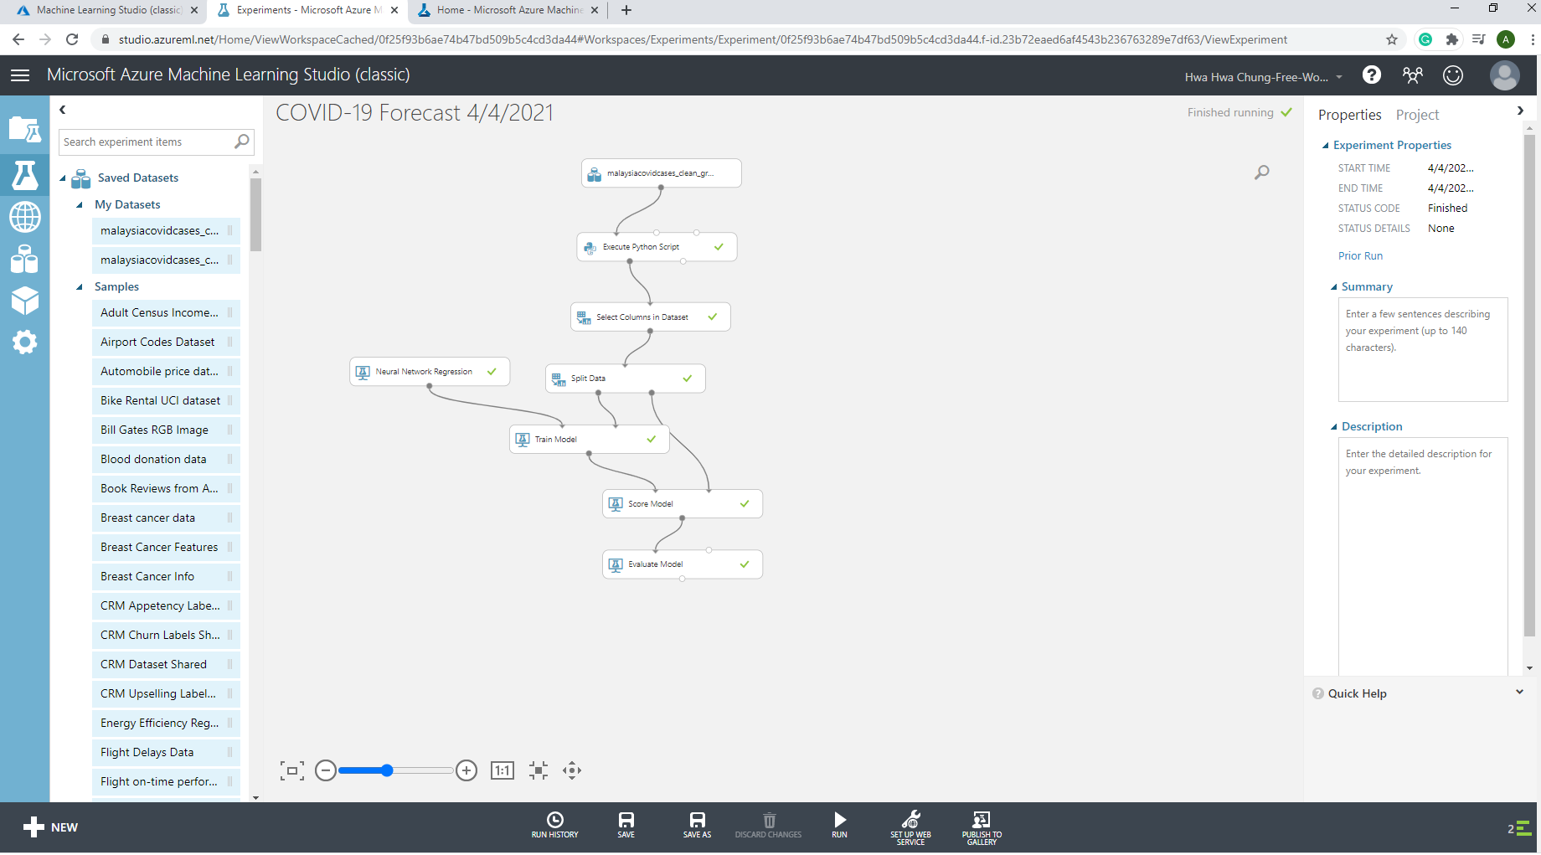
Update dataset and train model

Slide 8
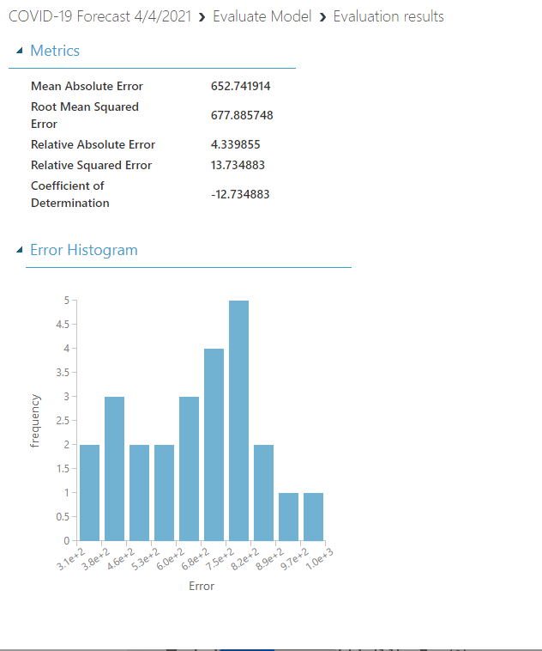
Model Evaluation

Slide 9
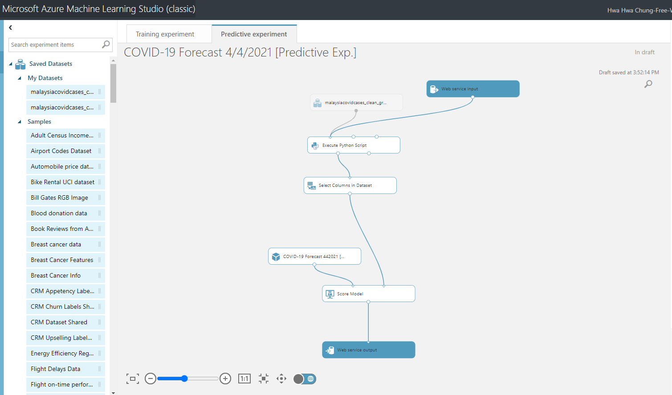
Convenient deployment of trained Azure ML model as web service

Slide 10
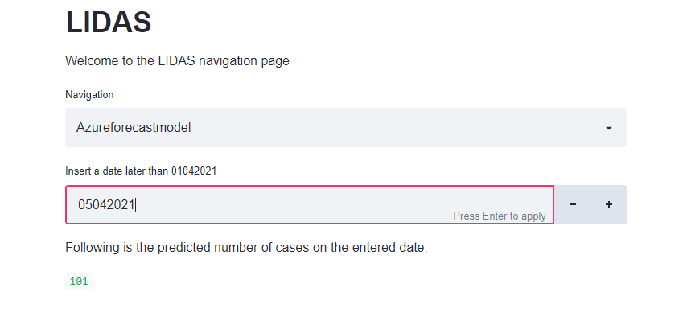
COVID-19 Forecast results by calling Azure ML studio API from Streamlit

